Slide 1

Know Diabetes: A Predictive Analytics Approach
Problem Statement Diabetes is one of the most significant public health challenges, with millions of cases going undiagnosed until serious complications arise.
Proposed Solution Develop a predictive modeling system to identify high-risk individuals before clinical onset, enabling timely interventions that can improve health outcomes and reduce healthcare costs.
Potential Impact
Early detection can lower complication rates, improve patient quality of life, and significantly reduce long-term treatment expenses for healthcare systems.

Slide 2
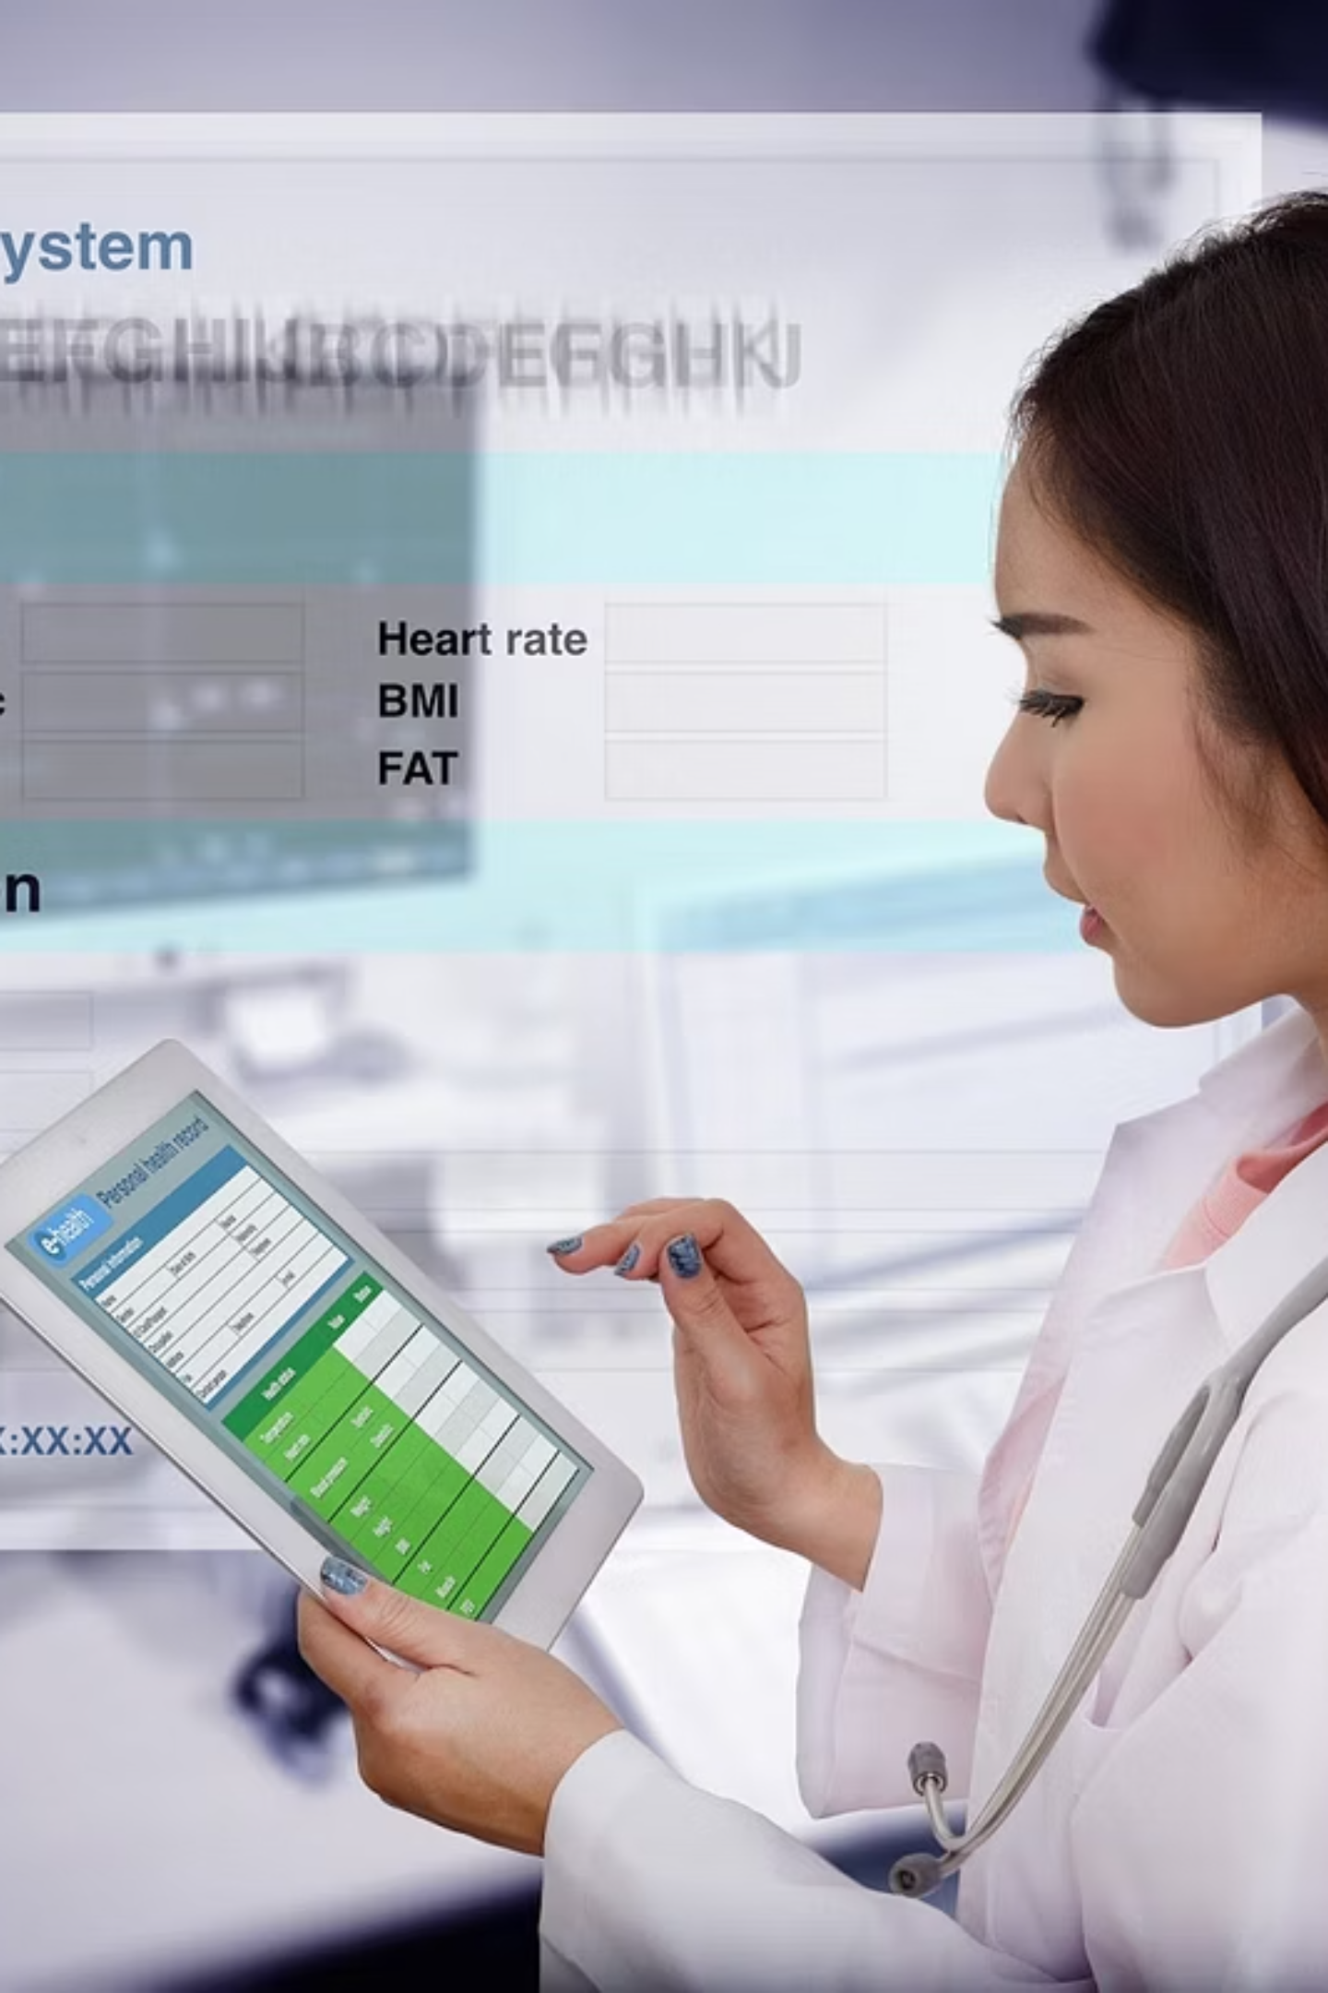
Comprehensive Dataset & Preprocessing Methodology
1
Robust Data Collection
253,680 records from CDC's Behavioral Risk Factor Surveillance System (BRFSS 2015), providing a comprehensive national sample through telephonic surveys
2
Rich Feature Set
21 key features including BMI, smoking status, insurance coverage, physical and mental health metrics, dietary habits, and alcohol consumption patterns
3
Clear Target Variable
Binary outcome indicator (Diabetes Class): 0 - No Diabetes, 1 - Has Diabetes, providing a clean classification target
4
Thorough Preprocessing
Comprehensive data cleaning including column standardization, null value handling, duplicate handling and appropriate encoding techniques (one-hot and ordinal)

Slide 3
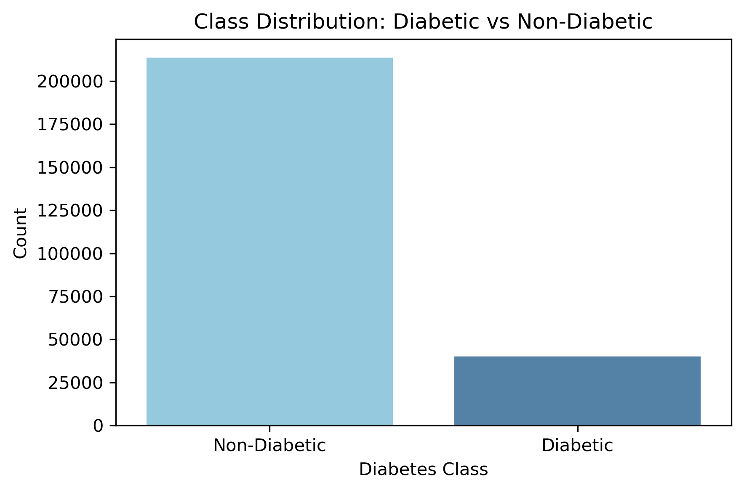
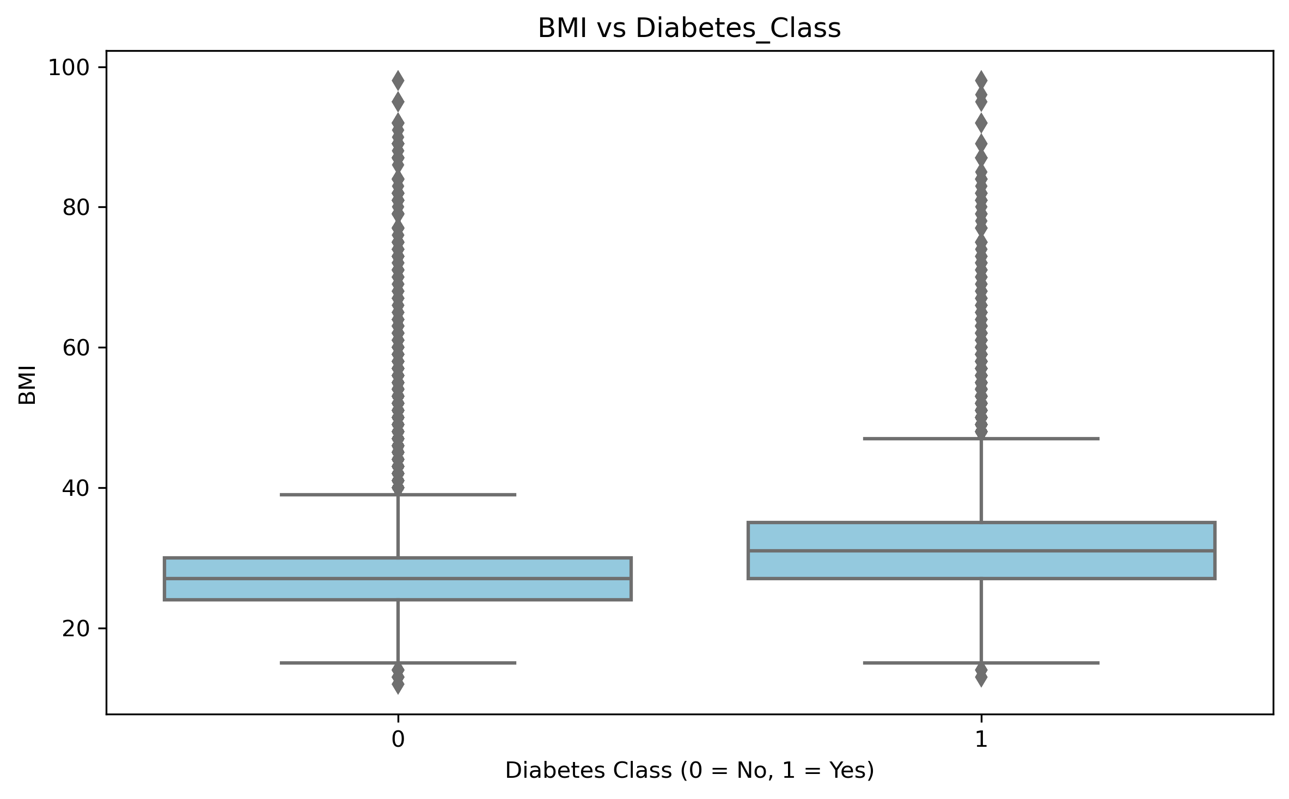
Key Insights from Exploratory Data Analysis
Class distribution is highly imbalanced — ~85% of respondents are non-diabetic, while only ~15% are diabetic.
BMI is notably higher among diabetics . BMI strongly linked to diabetes risk

Slide 4
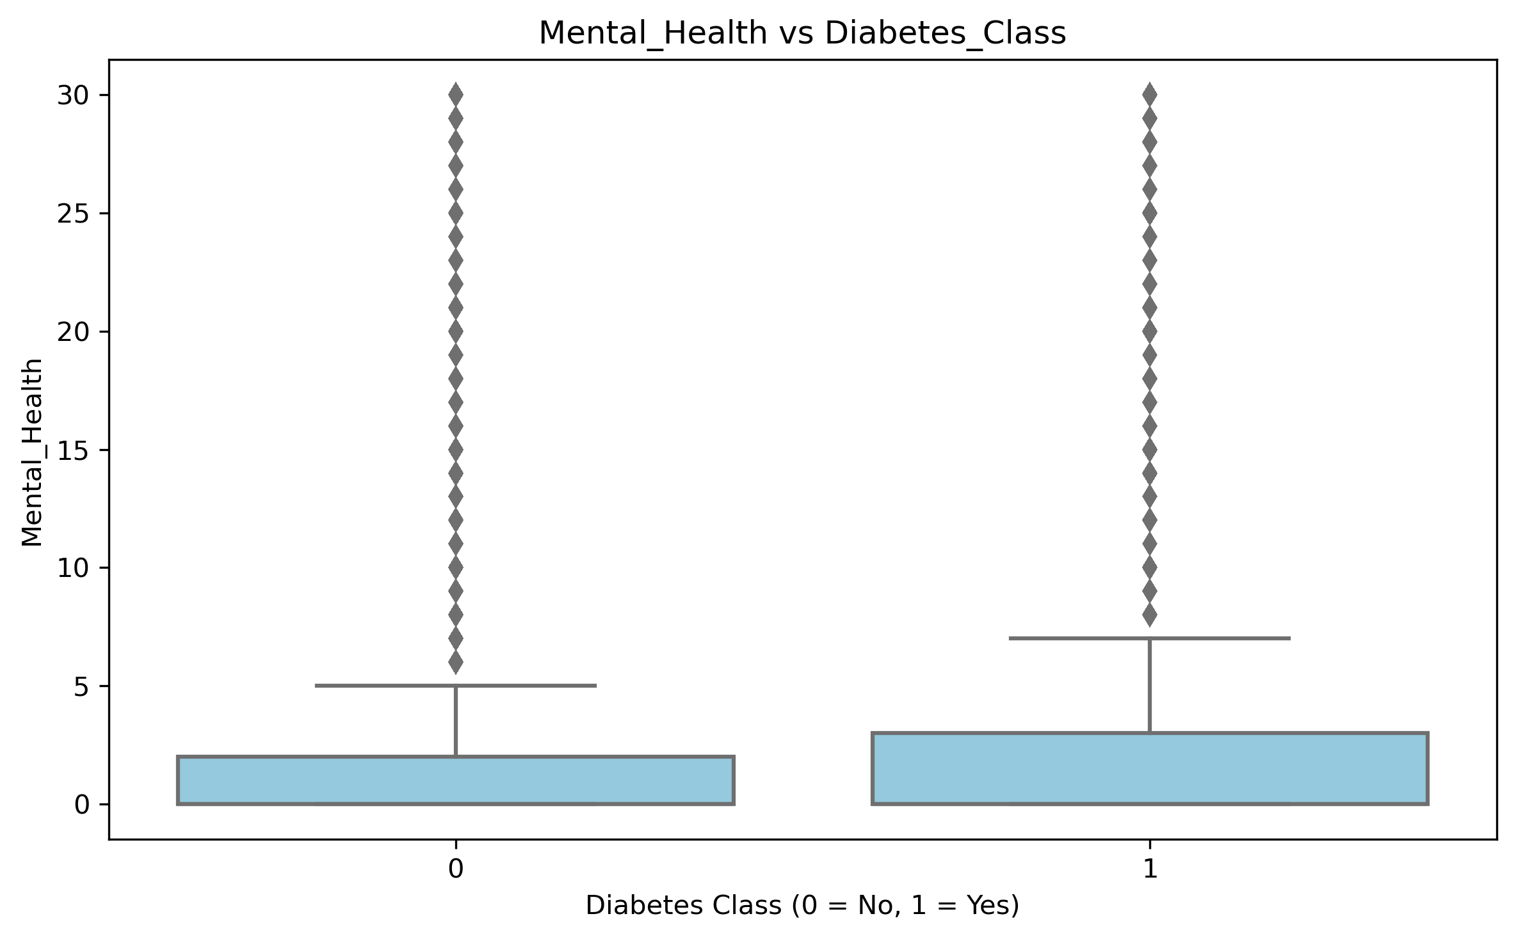
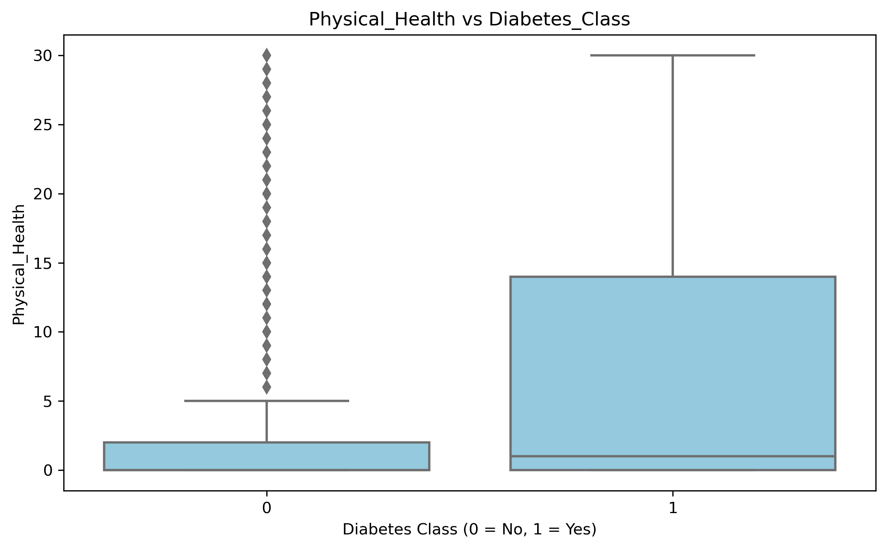
Key Insights from Exploratory Data Analysis
Poor mental health days are higher among diabetics
Poor physical health days are significantly higher in diabetics, with a wider range of severe cases

Slide 5
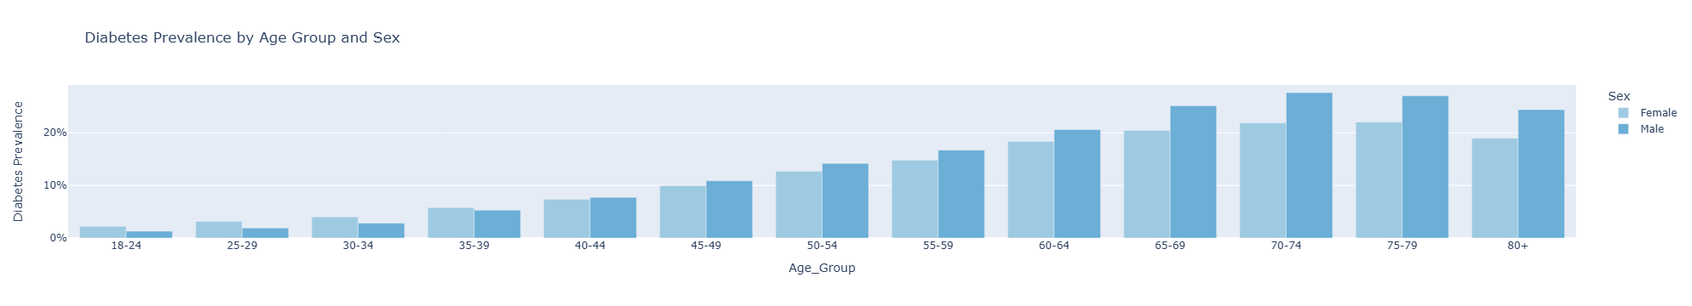
Key Insights from Exploratory Data Analysis
Demographic Patterns
Diabetes prevalence steadily increases with age, peaking in the 70–74 range. Across most age groups, men consistently show higher prevalence than women, with the gender gap widening in older age brackets.

Slide 6
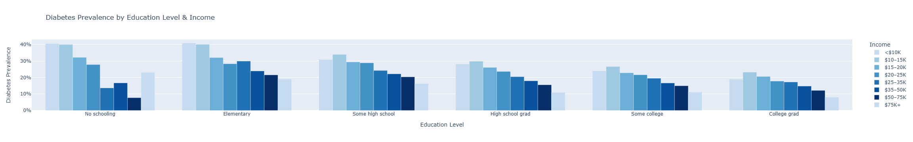
Key Insights from Exploratory Data Analysis
Socioeconomic Factors
Lower education and income levels are strongly associated with higher diabetes prevalence, suggesting that socioeconomic status plays a significant role in health outcomes and access to preventive care

Slide 7
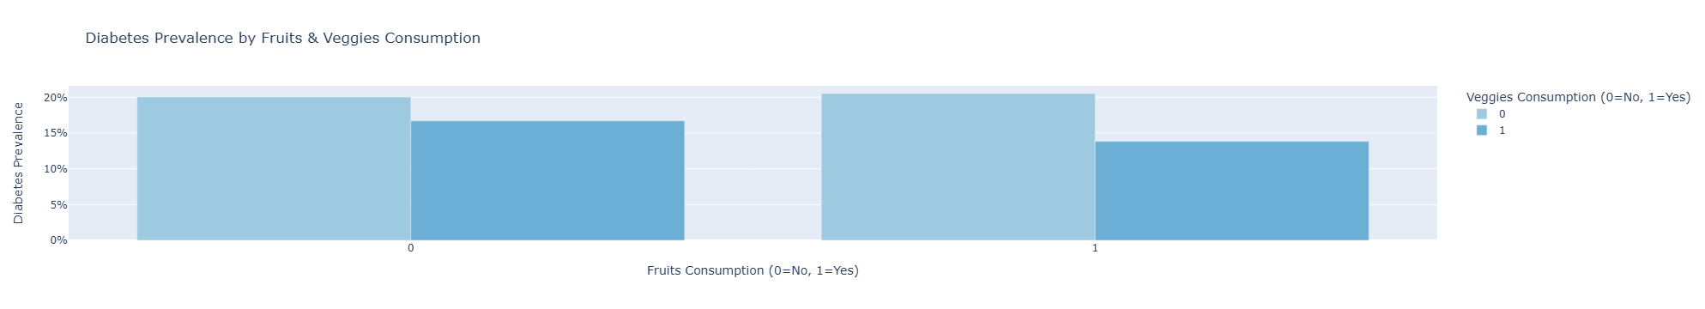
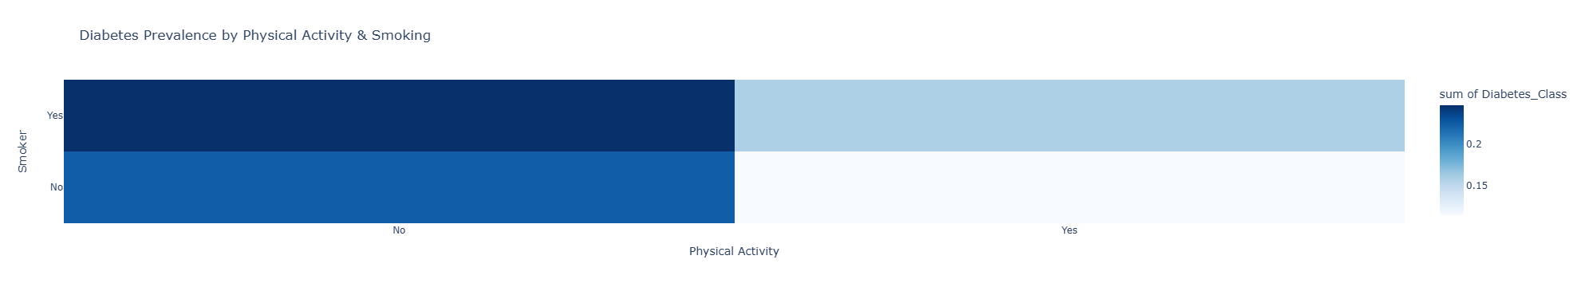
Key Insights from Exploratory Data Analysis
Lifestyle Correlations
Physical inactivity, smoking history, and poor dietary habits demonstrate strong associations with increased diabetes risk

Slide 8





Baseline Modelling-Steps
80/20 Training & Test Split
Stratified to preserve class proportions and avoid bias
Scaled the Data
Prevented one feature from dominating due to unit differences.
Logistic Regression-Normal
Instantiated, fitted the training data and transformed the test data. No parameters were changed. Recall most important metric. High accuracy achieved, poor recall and precision for class 1
Logistic Regression-Balanced
Class weight as ‘balanced’ was selected. Accuracy dropped, but higher recall and lower precision was achieved
Logistic Regression-Upsampling
Minority class were duplicated. Accuracy slightly higher than log-balanced but lower than normal. Slightly higher recall achieved & precision was almost similar

Slide 9
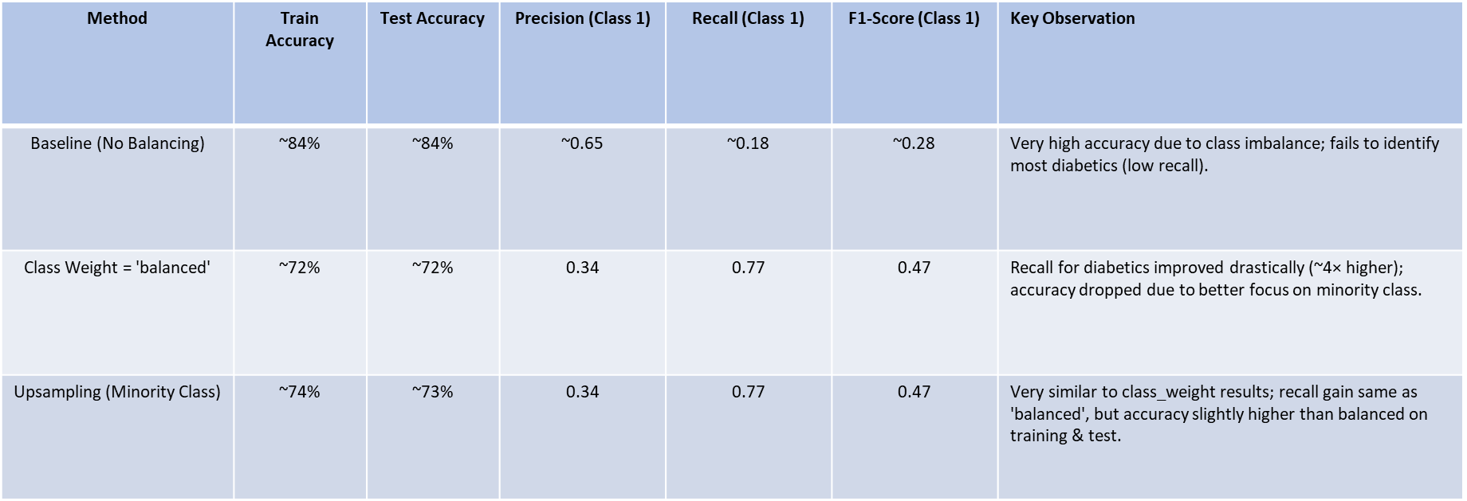
Baseline Model Summary-Logistic Regression

Slide 10
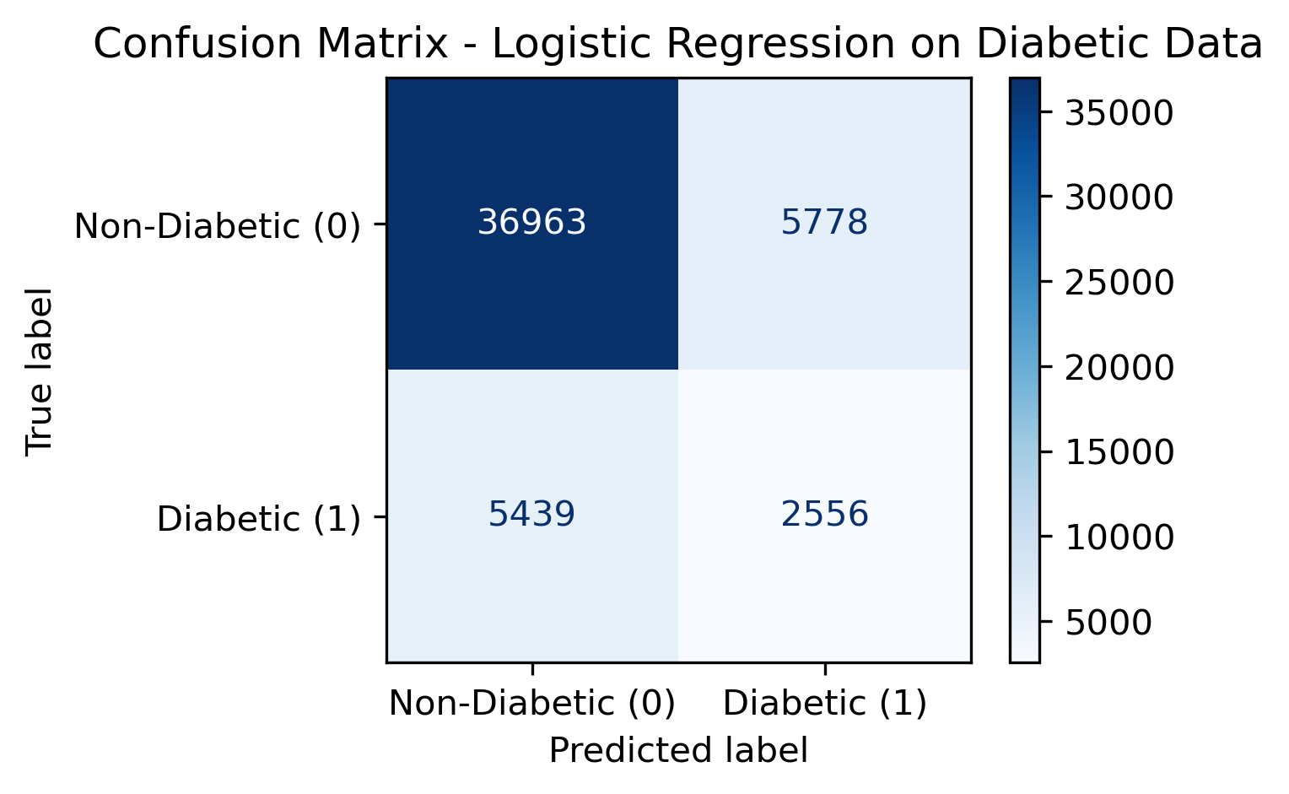
Evaluation Metrics
Classification Report
A summary of model’s performance was generated which showed the accuracy, precision, recall and F1- score.
Recall was considered as the most important evaluation metric. False positives can be detrimental
Confusion Matrix
A table which shows how well a classification models prediction matches the actual results.
Gives an idea about FP, FN,TP & TN
ROC-AUC Curve
Tool for evaluating how well a classification model can separate two classes (e.g., diabetic vs. non-diabetic)
across all possible probability thresholds.
Precision Recall Curve
PR Curve focuses only on the positive class (minority), making it more sensitive to performance drops in rare-event detection.

Slide 11
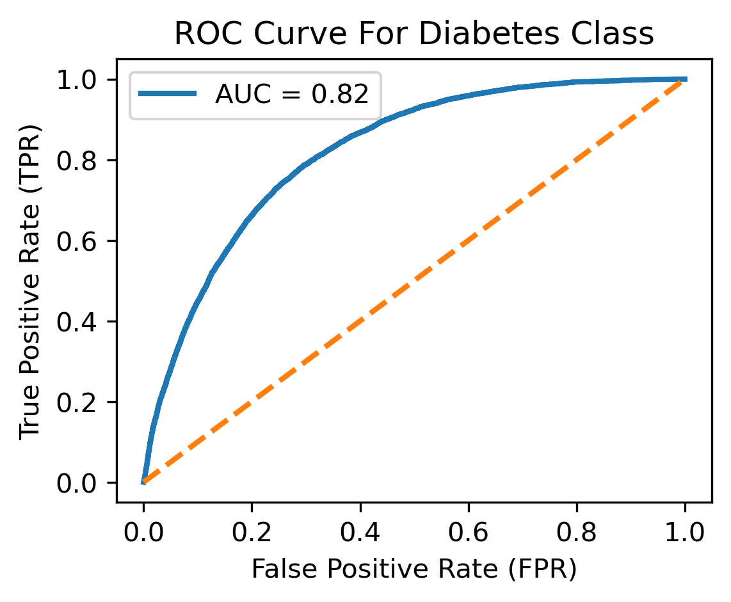
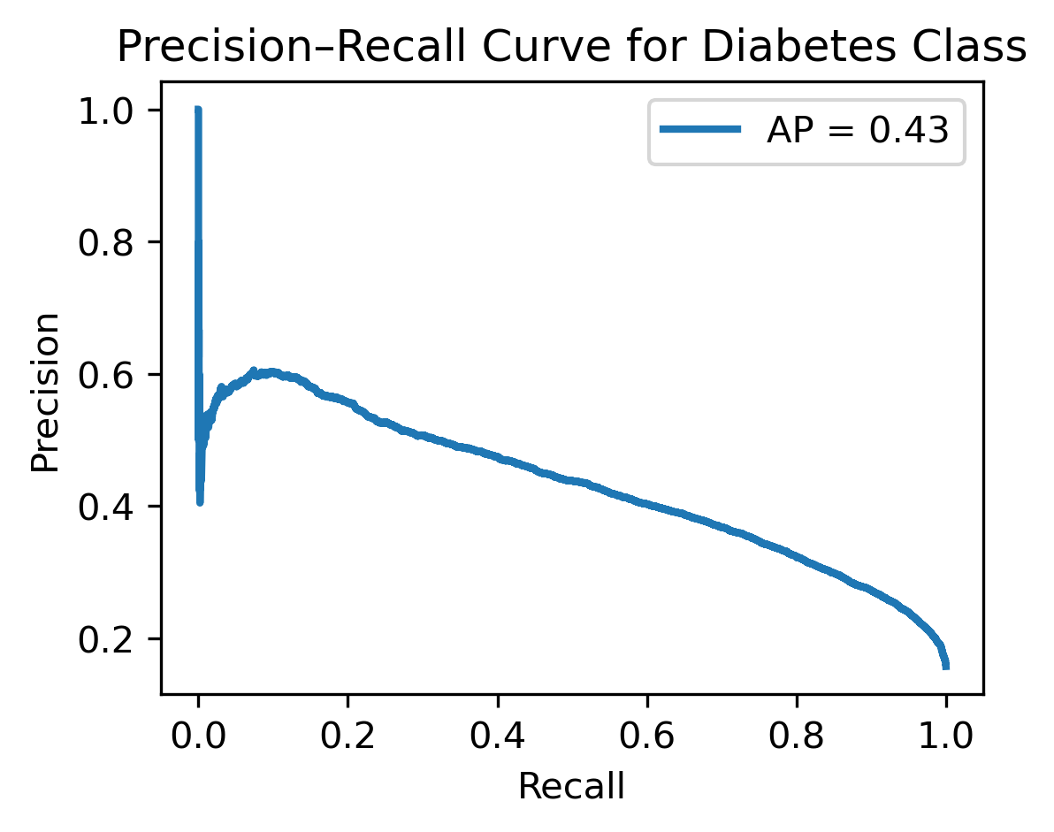
Evaluation Metrics (Contd.)
ROC Curve (AUC = 0.82)
The ROC curve shows strong overall discrimination between diabetes and non-diabetes cases, but can appear optimistic in imbalanced datasets as it includes many true negatives
PR Curve (AP = 0.43)
The PR curve focuses only on the positive (diabetes) class, revealing the trade-off between precision and recall; the lower score reflects the challenge of detecting the minority class.

Slide 12
Implementation Roadmap & Future Directions
Advanced Model Development
1
Implement ensemble methods including Random Forest and XGBoost to improve predictive performance and model robustness
Optimization
2
Conduct comprehensive hyperparameter tuning to identify optimal model configurations for both accuracy and computational efficiency
Clinical Integration
Develop and deploy a web-based screening tool for healthcare providers enabling real-time risk assessment during patient encounters
3
Continuous Improvement
Establish monitoring protocols to evaluate model performance over time and implement scheduled retraining with updated clinical datasets
4

Slide 13
THANK YOU- ANY QUESTIONS ?

